Slide 1
AstroStatistics 2020 C03

Slide 2
Transformations of Random Variables:
Any function of a random variable is itself a random variable. It is a common case that we measure a variable x, but the interesting final result is a function y(x). If we known the distribution p(x), what is the distribution p(y), where y=ɸ(x), i.e. x=ɸ⁻¹ (y). It is easy to show that:
p(x) |dx| = p(y) |dy| => p(x)=| dy/dx | p(y)
In higher dimensions, the transformations of a distribution is done by multiplying it by Jacobian, the determinant of the matrix of partial derivatives of the change of coordinates.
If we take p(y)=1 in the unit interval and integrate both sides this relationship has useful implications:

Slide 3
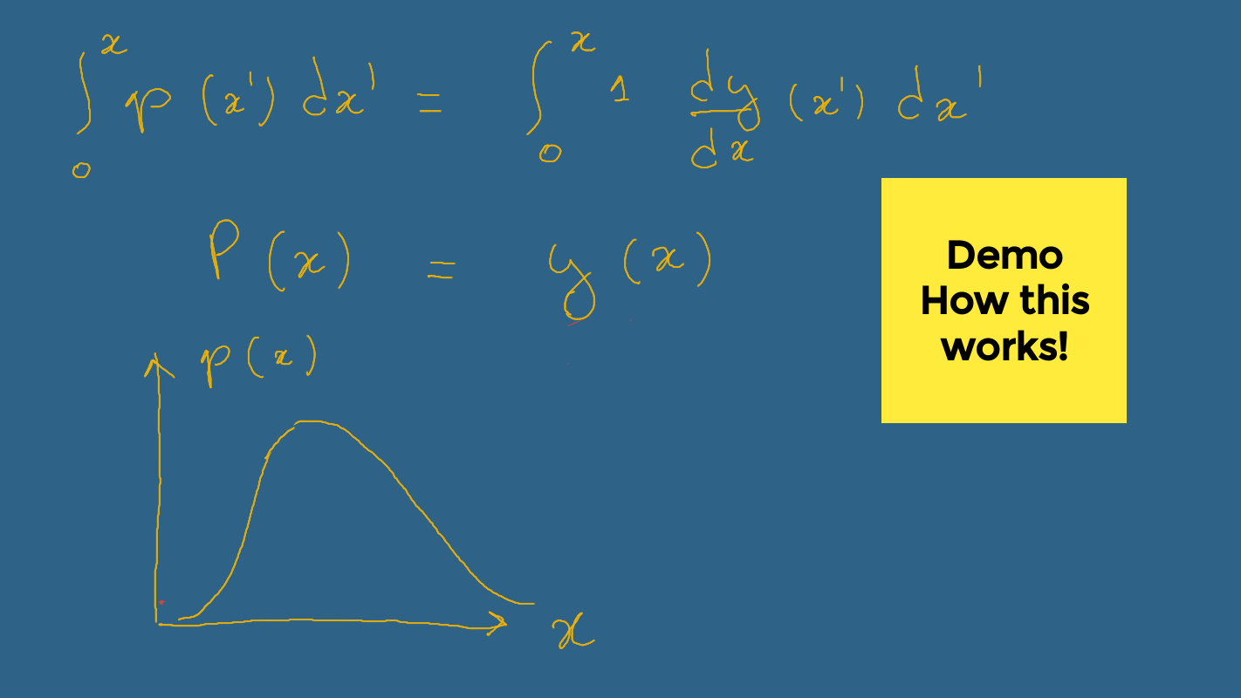
Transformations of Random Variables:

Slide 4
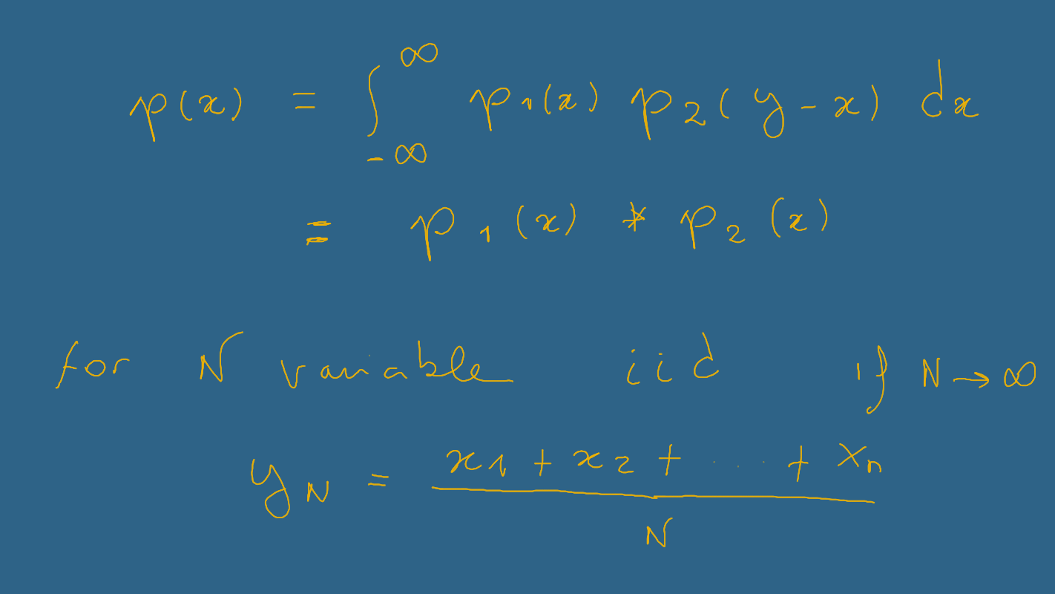
Transformations of Random Variables:
This means that if we choose the transformation y(x) to be the integral P(x) of a given distribution p(x), and pick random values of from a uniform distribution, then the corresponding values of x will be distributed according to p.
The next question is how to combine random variables. The simplest operation is adding two independent random variables, x1 drawn from p1 and x2 drawn from p2, to create a new variable y=x1+x2. To find the
probability function p(y), we must add up the probabilities for each of the different ways that x1 and x2 is given by the product of the probabilities, and so integrating we see that: the p(x) for a sum of two random variables is the convolution of the individual distributions.
the distribution of y is equal to the distribution of x convolved with itself N times, and since taking a Fourier transform turns convolution to multiplication, the Fourier transform of the distribution of y is equal to the product of N transforms of the distribution of x. This suggest an important role for Fourier Transforms in studying random processes.

Slide 5
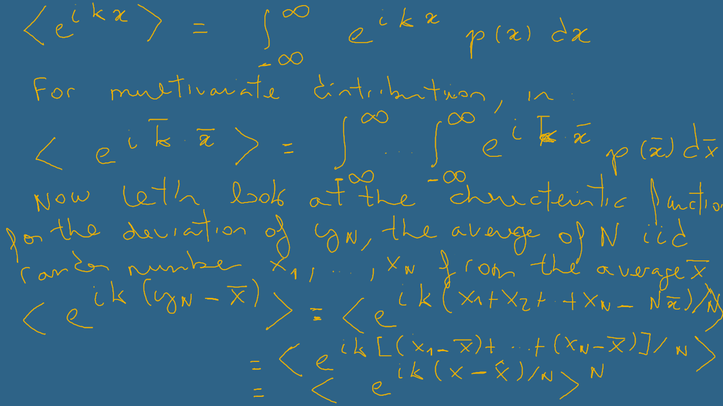
The Fourier Transform of a probability distribution is called the characteristic function, and is equal to the expectation value of the complex exponential.

Slide 6
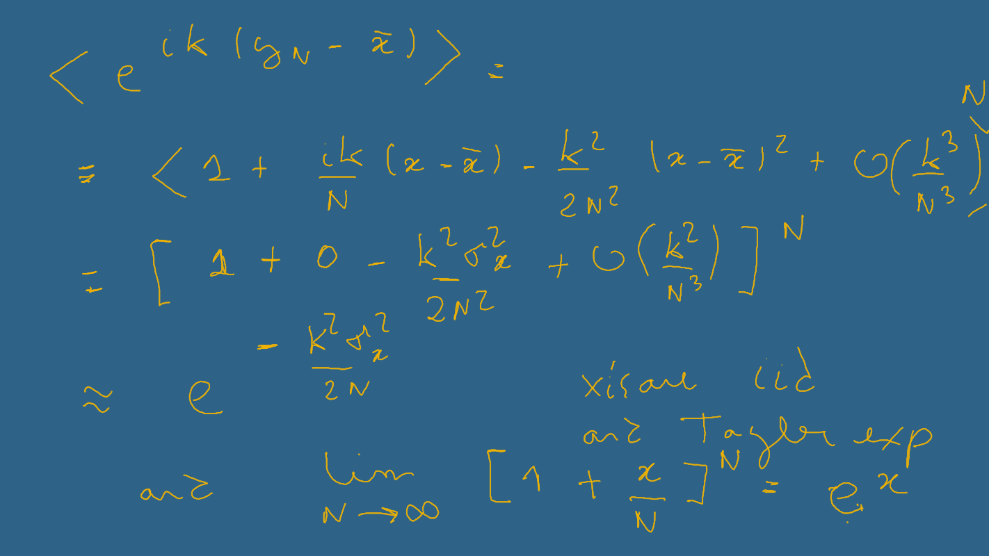

Slide 7
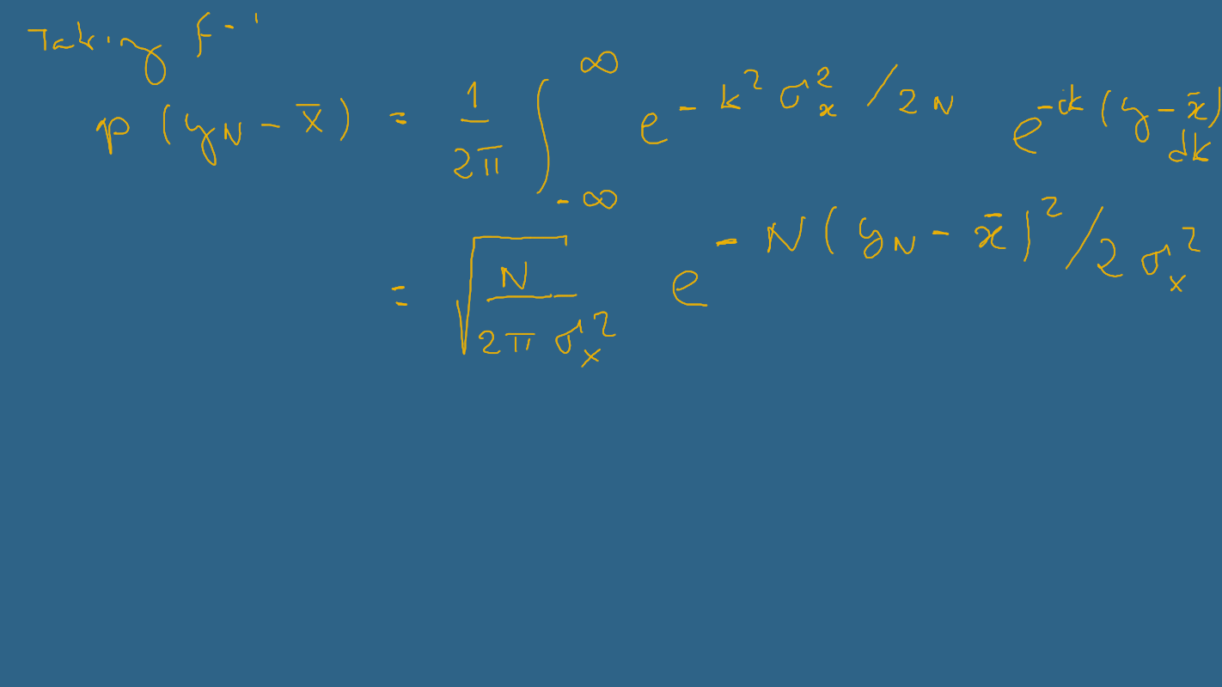
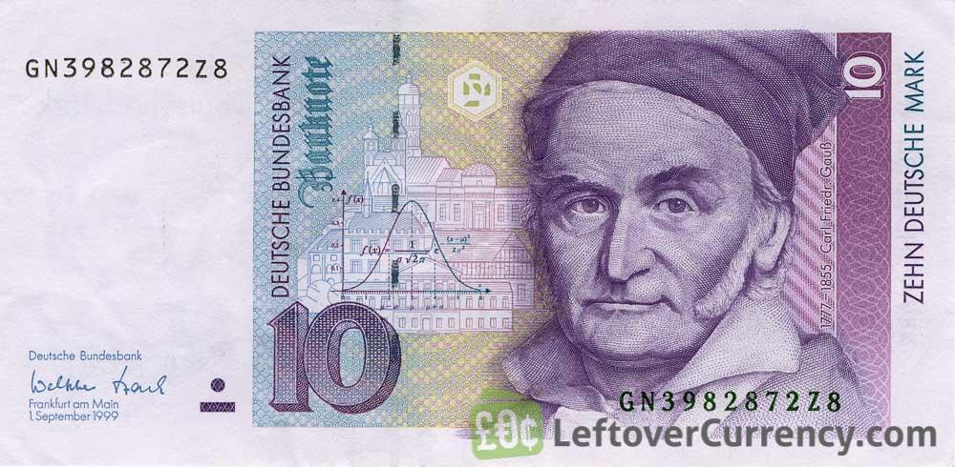
Something remarkable has happened: in the limit N -> ∞, the sum of the N variables approach a Gaussian distribution, independent of the distribution of the variables ! This is called the Central Limit Theorem, and explain why Gaussians are so important studying random processes.
Since the standard deviation is σ / √N , which vanishes when as N -> ∞, previous equation also contains the Law of Large Numbers: the average of a large number of random variables approach the mean, independent of the distribution. Coffee break: https://www.youtube.com/watch?v=EvHiee7gs9Y Q1: comment about it! The characteristic function takes on interesting form if he complex exponential is expanded in power series:

Slide 8
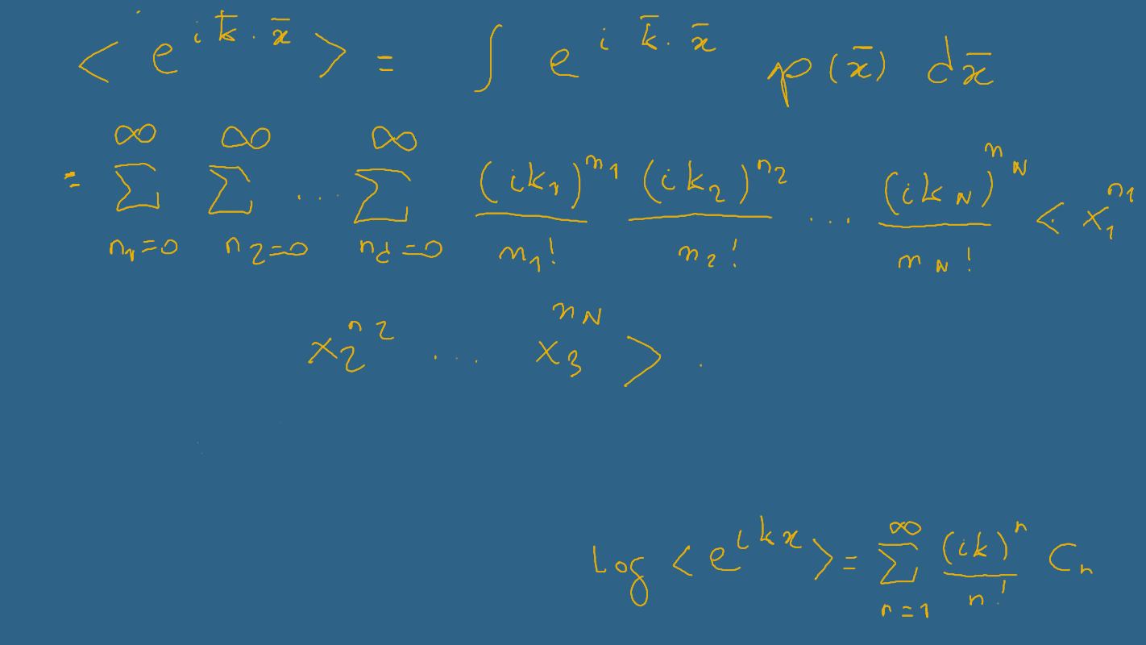
This provides a relationship between the moments of a distribution and the distribution itself (via its Fourier transform). For this reason, the characteristic function is also called the moment generating function. If the characteristic function is known, the moments can be found by taking derivatives of the appropriate order and evaluating at K=0 (only one term will be nonzero).
Another important object is the logarithm of the characteristic function. If we choose to write the this as a power series in k of the form (for the 1D case) .
This defines the cumulants Cn, which can be found by
comparing this to the power series expansion of the characteristic function. Q2:

Slide 9
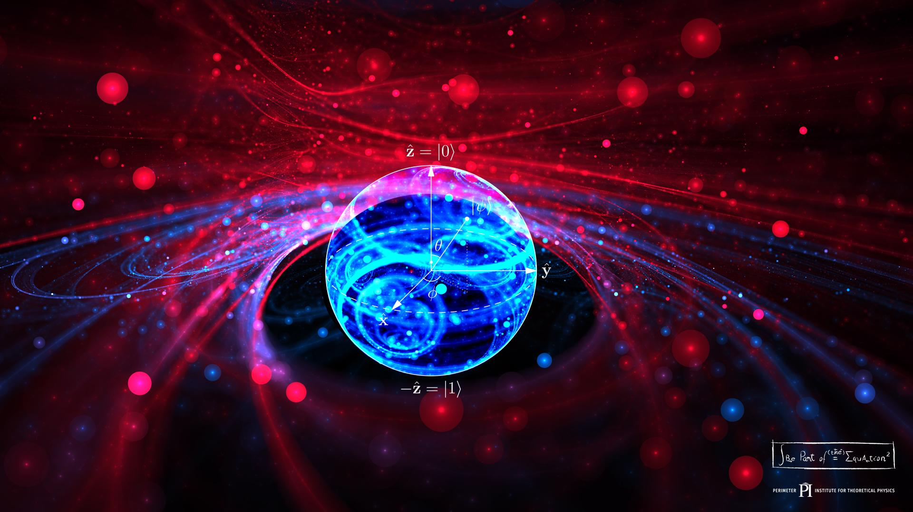

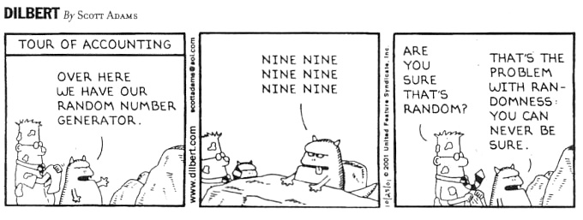
Random Number Generators:
There is a frequent and apparently paradoxical need to use a computer to generate random numbers. In modelling a stochastic system it is necessary to include a source of noise, but computers are (hopefully) not noisy.
One solution is attach a computer peripheral that performs a quantum measurement that perform a quantum quantum measurement (which as far we known can be completely random), or perhaps measure the fluctuations in your coffee cup (which are extremely random). https://www.ibm.com/quantum-computing/learn/what-is-quantum-computing/
https://www.scientificamerican.com/article/quantum-computing-may-be-closer-than-you-think/
There is a large difference in what is required to fool
a player of a video game and a cryptographic analyst.

Slide 10
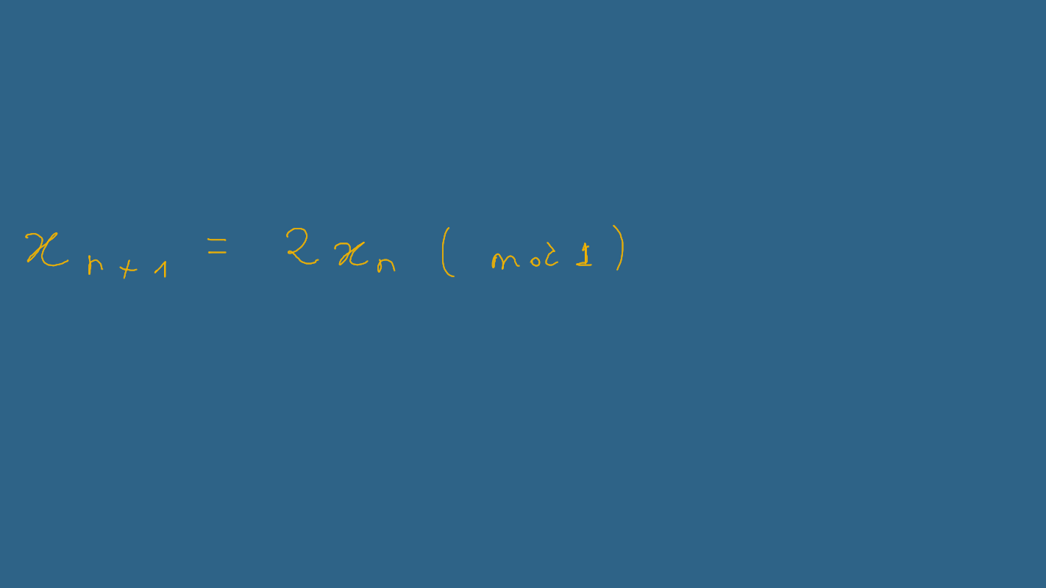

https://www.quantamagazine.org/how-to-turn-a-quantum-computer-into-the-ultimate-randomness-generator-20190619/
There is a corresponding broad range of choices for random number generators, based on how the sensitive your problem is to hidden order that must be present that must be present in any deterministic algorithm.
Linear Congruential random Number generators: and more sophisticated variants are the most common techniques used for programing random numbers. The simplest example is the map:
Starting with an initial value for x0 (chosen to be
between 0 and 1) this formula generates a new series
of values. The procedure is take the old value multiply
it by 2 and take the part that is left after dividing by 1
(i.e. the fractional part ), and use it as the new value.
But how random are the successive values of x?
Q3: generate and evaluate it using python code,
plotting pairs of consecutive “random” numbers.
and consider the fractional binary expansion of x!

